Slide 1

CART Benefits Module
Draft-Version6
Conservation Planning
(Environmental) Benefits
SPSD Leadership
December 2021

Slide 2
Environmental Benefits and Outcomes
Environmental Benefits
Environmental Benefits => as outlined in the 2018 Farm Bill directs NRCS to prioritize Conservation Planning and Program Delivery (e.g. most conservation for least cost)
Outcomes => as outlined in the 2018 Farm Bill directs NRCS to articulate more than Conservation Outputs (i.e. # of Contracts, Acres Treated, Dollars Invested)
Both Environmental Benefits and Outcomes can be represented similarly (e.g. tons of soil saved, expected nutrient load reductions, energy savings, etc.)
Environmental Benefits and Outcomes are both referenced repeatedly in the 2018 Farm Bill

Slide 3


Environmental Benefits and Outcomes
Environmental Benefits
Both Environmental Benefits and Outcomes should be based on science
Conservation Planning Benefits = Environmental Benefits
Environmental Benefits => responsibility of the Conservation Planning and Technical Assistance Division
Outcomes => responsibility of the Resource Inventory and Assessment Division

Slide 4
Environmental Benefits and Outcomes
Objectives
Provides clear roles for Environmental Benefits and Outcomes within NRCS
Facilitates the integration of Conservation Planning (Environmental Benefits) and Outcomes
Capitalizes on science of soils database, CEAP, etc. for conservation planning
Allows for estimation of Environmental Benefits at individual, watershed, landscape, and national level; and by program (scalable and longitudinal) for both planned and installed conservation practices
Improves CART planning data using the CAPP framework
Facilitates future development of environmental services, and economics of conservation, and expansion of Outcomes

Slide 5

Environmental Benefits and Outcomes
Objectives
Outcomes
Results on
America’s
Private Lands
Environmental Benefits
Conservation Planning:
Land Use, Resource Concerns, Existing Conditions,
Planned Conditions w/Practices, CART Point System

Slide 6
Conservation Planning (Environmental) Benefits

Slide 7
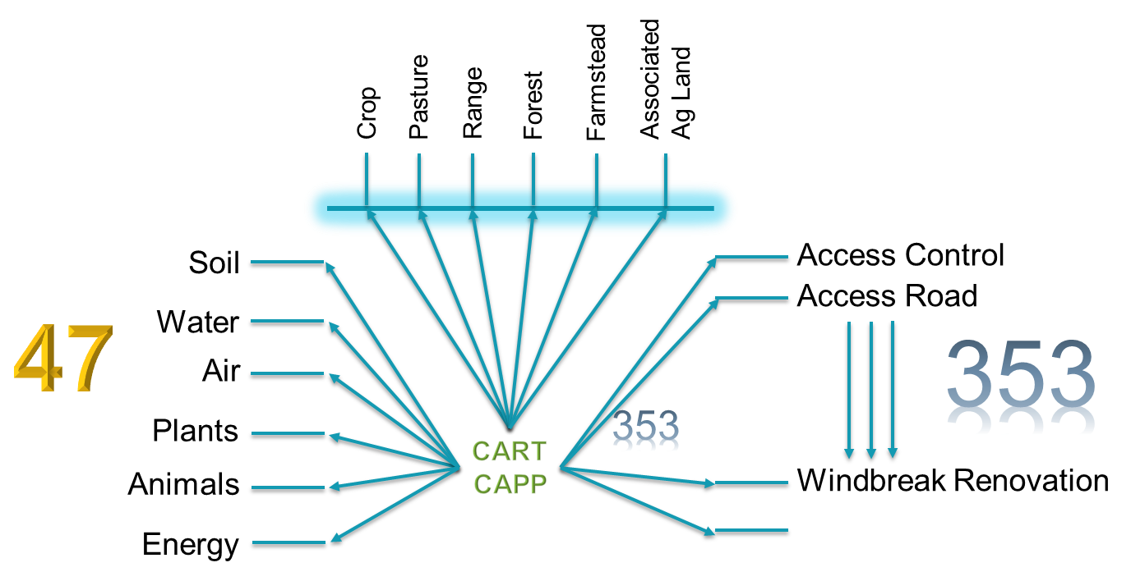
CART Data Collection
Data Collection and Availability
CART is now collecting tens of millions of data points annually facilitating Environmental Benefits Calculations
CART Data
Plans
Land Units
Resource Concerns
Practice/Systems of Practices
Date Planned/Implemented
Geospatial Extent
Geospatial Lines/Points
Geospatial Polygons
CART Numeric Points
Threshold
Existing Condition
Planned Condition (CAPP database)

Slide 8
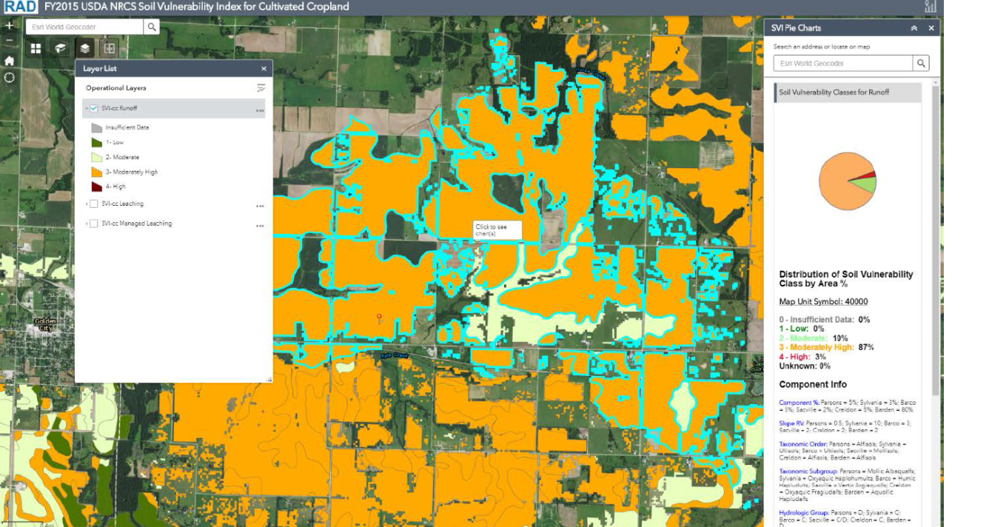
Benefit Development
Levels of Environmental Benefits
Level-1 – Soil Vulnerability Index, Geospatial Layers, Planner Input, and CAPP database => conservation practice has X effect (current for most)
SVI + Geospatial Layers
= Existing Condition –
local based on soils
CAPP = Planned Condition - national at this point

Slide 9
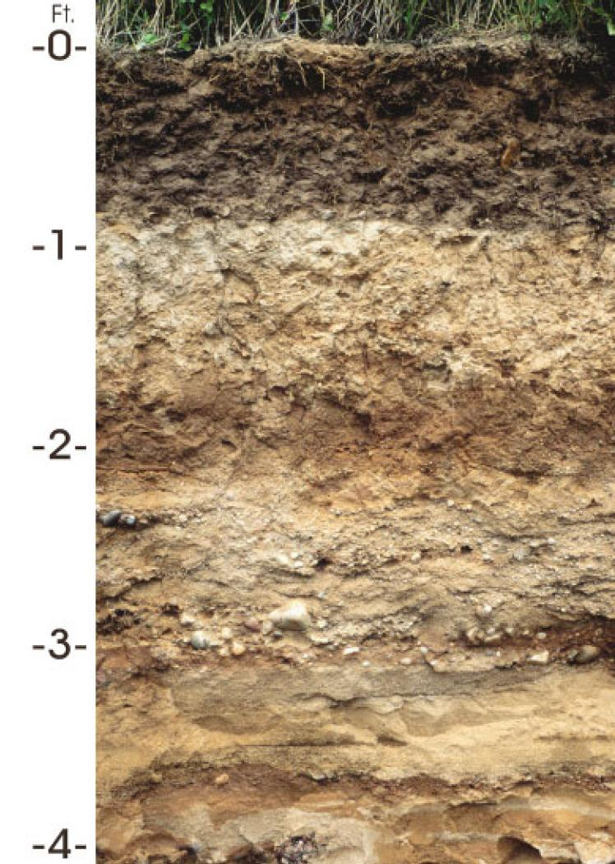
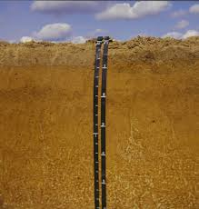
Benefit Development
Levels of Environmental Benefits
Level-2 – CAPP database updated with soil interpretations and/or logic modeling => conservation practice on this soil has X.0 effect (soil interpretations, logic modeling, etc.)
In the works!
Soil Interpretations help
localize the
Environmental Benefits
for conservation practices
like Cover Crops during
conservation planning
70,000 kinds of soil
Antigo Silt Loam
Tifton Loamy Sand

Slide 10
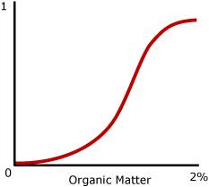
Benefit Development
Levels of Environmental Benefits
Level-2 – Example-1 – Cover Crop
Resource Concern – Soil – Organic Matter Depletion
2.5%
1.3%
Existing
Existing
Antigo Silt Loam
Tifton Loamy Sand

Slide 11
Benefit Development
Levels of Environmental Benefits
Level-2 – Example-1 – Cover Crop
Resource Concern – Soil – Organic Matter Depletion
CEMA
2.5%
1.3%
Planned
Existing
Planned
Existing
Antigo Silt Loam
Tifton Loamy Sand

Slide 12
Benefit Development
Levels of Environmental Benefits
Level-2 – Example-1 – Residue Management
Resource Concern – Water – Surface Water Depletion
12.53 cm
11.47 cm
Available
Water
Capacity
Antigo Silt Loam
Tifton Loamy Sand

Slide 13
Benefit Development
Levels of Environmental Benefits
Level-2 – Example-1 – Residue Management
Resource Concern – Water – Surface Water Depletion
CEMA
12.53 cm
11.47 cm
Available
Water
Capacity
Antigo Silt Loam
Tifton Loamy Sand

Slide 14
Benefit Development
Levels of Environmental Benefits
Level-3 – CAPP database updated with practice narratives (e.g. practice intensity) => conservation practice of this intensity, and on this soil, has X.00 effect
Including practice
“narratives” adds to
location details of
Environmental Benefits
for conservation planning

Slide 15
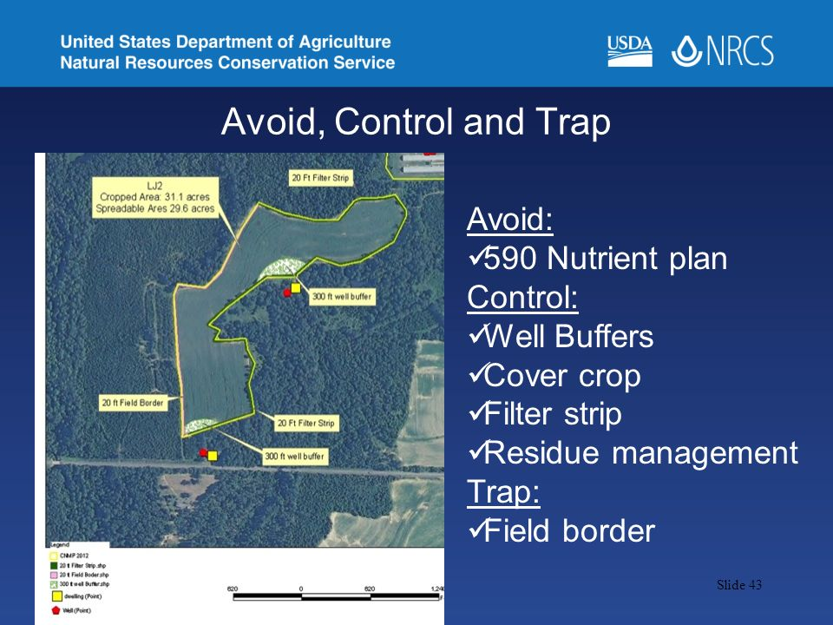
Benefit Development
Levels of Environmental Benefits
Level-4 – CAPP database updated with CEAP data => conservation practice with CEAP modeling, of this intensity, and on this soil has X.000 effect
Including CEAP Science
and Modeling principles
further improves
Planned Conditions
of Environmental Benefits
for conservation planning

Slide 16
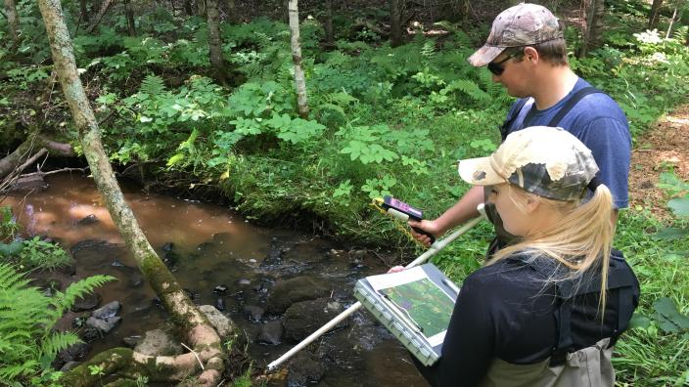
Benefit Development
Levels of Environmental Benefits
Level-5 – CAPP database updated with all the above and empirical data and/or localized literature
Empirical Data Collection
will help fill in the gaps to
calibrate our
CAPP database

Slide 17
Benefit Development
Levels of Environmental Benefits
Level-1 – Soil Vulnerability Index, Geospatial Layers, Planner Input, and CAPP database => conservation practice has X effect (current for most)
Level-2 – CAPP database updated with soil interpretations and/or logic modeling => conservation practice on this soil has X.0 effect (soil interpretations, logic modeling, etc.)
Level-3 – CAPP database updated with practice narratives (e.g. practice intensity) => conservation practice of this intensity, and on this soil, has X.00 effect
Level-4 – CAPP database updated with CEAP data => conservation practice with CEAP modeling, of this intensity, and on this soil has X.000 effect
Level-5 – CAPP database updated with all the above and empirical data and/or localized literature
Note: Levels don’t have to be developed sequentially

Slide 18
Environmental Benefits and Outcomes
Levels of Environmental Benefits
Each combination of Levels
gets Environmental Benefits
closer to better feeding
Outcomes
Outcomes
CEAP-Cropland
CEAP-WLFW
CEAP-Grazing
CEAP-Watersheds
Empirical Data
Literature Reviews
Level-5
CEMA
Level-4
Conservation Practice Database
Environmental Benefits
Practice Narratives
Level-3
Level-2
Dynamic Soils Hub
CCBI
SVI
Level-1
CEAP
Comet
Conservation Planning:
Land Use, Resource Concerns, Existing Conditions,
Planned Conditions w/Practices, CART Point System
CART

Slide 19
Environmental Benefits
Conservation Planning Benefits Estimation

Slide 20
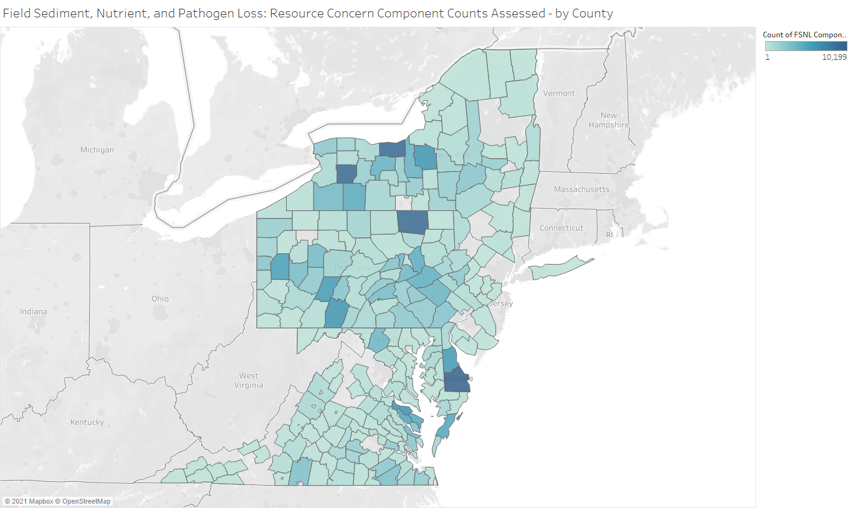
Conservation Planning – Program Delivery
Environmental Benefits
Time Planner selected
WQ Resource Concerns
on Cropland
Notes:
FY20-21 Count of Field Sediment, Nutrient and Pathogen Loss RC Components – darker = more RCC assessed

Slide 21
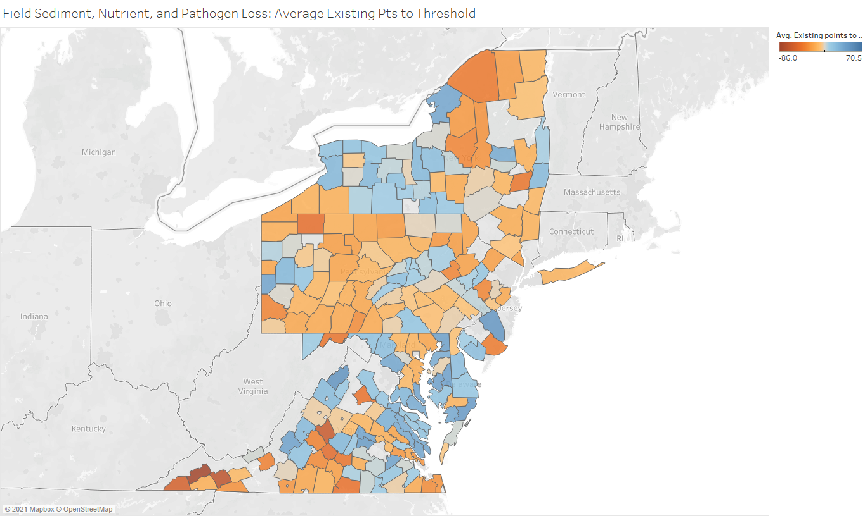
Conservation Planning – Program Delivery
Environmental Benefits
Average Existing Condition
Geospatial + Existing Practice
for WQ Resource Concerns
on Cropland
Notes:
“Before planning”
Averages of the existing points (condition and practice) for all the RCC in the Field Sediment, Nutrient and Pathogen Loss RC for each county
Reds= below threshold (0); Blues = above threshold
FY20-21

Slide 22
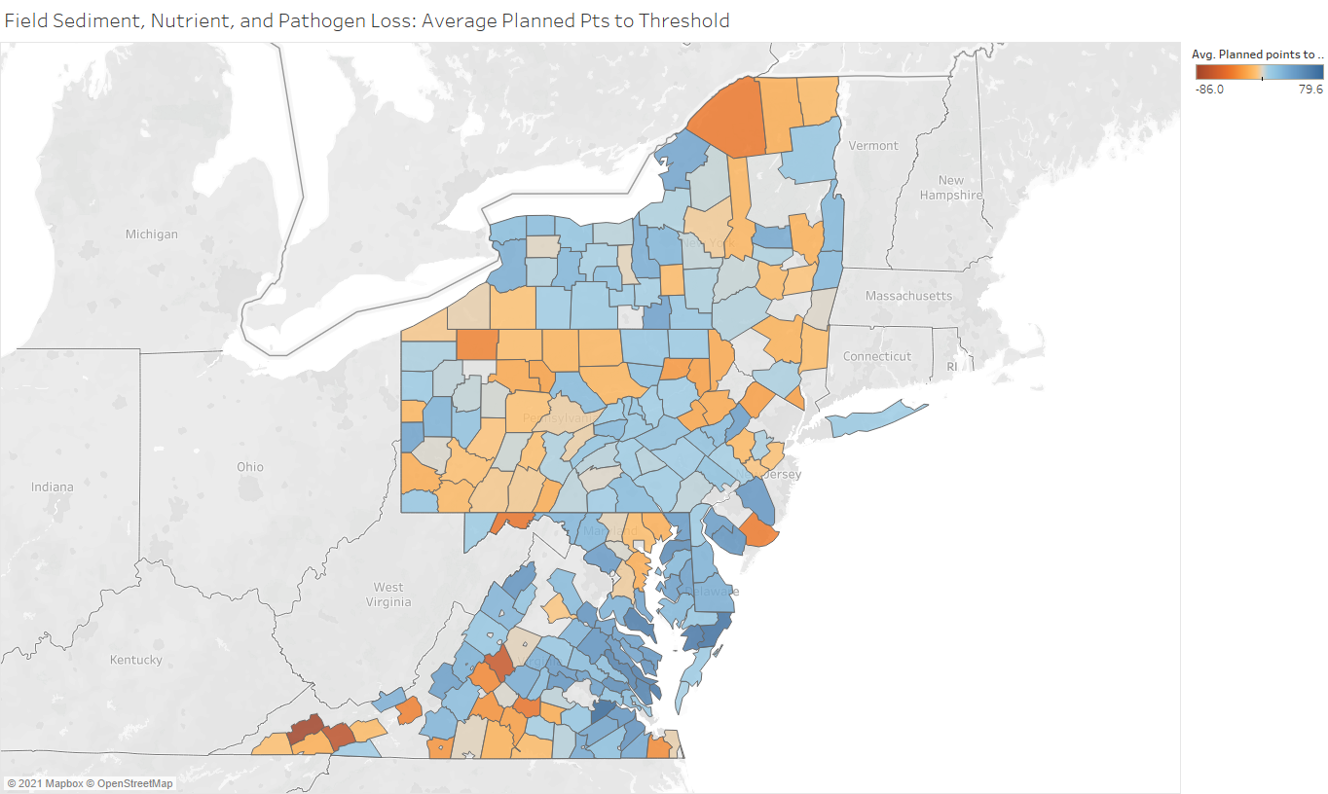
Conservation Planning – Program Delivery
Environmental Benefits
Average Planned Condition
Geospatial + Existing Practice
for WQ Resource Concerns
on Cropland
Notes:
“After planning”
Averages of the planned points for all the RCC in the Field Sediment, Nutrient and Pathogen Loss RC for each county
Reds= below threshold (0); Blues = above threshold – can see several, but not all, counties moved from red to blue with planning
The delta for each county between last slide and this slide would be the avg of planned practices points.
FY20-21

Slide 23
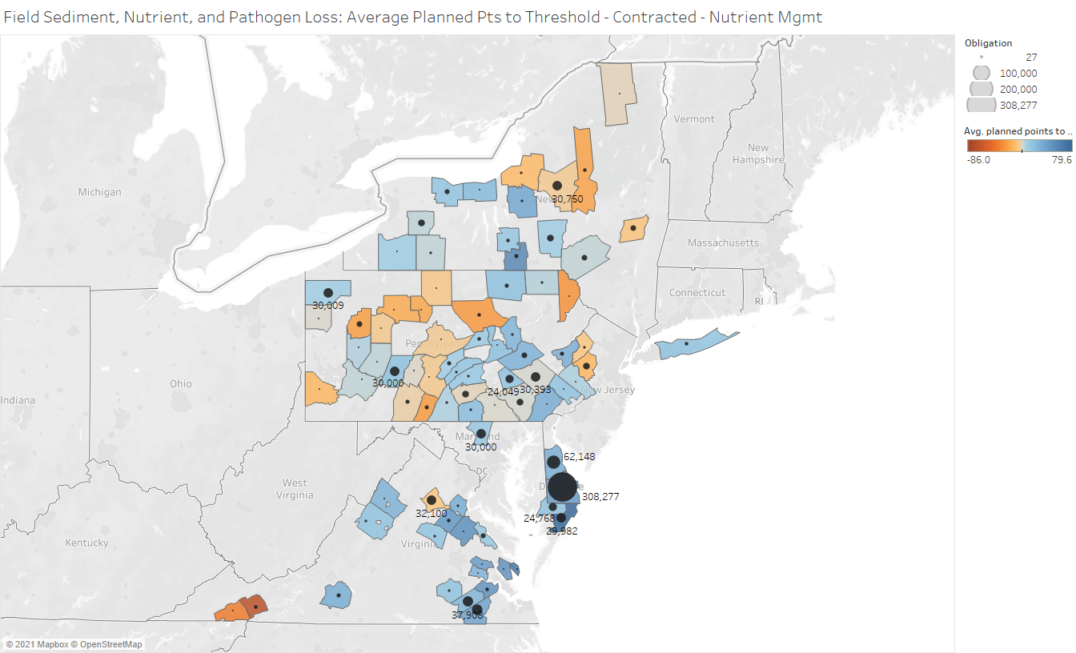
Conservation Planning – Program Delivery
Environmental Benefits
Average Planned Condition
Geospatial + Existing Practice
for WQ Resource Concerns
on Cropland
CONTRACTS
Notes:
Takes the “Contracted” counties and filters them further to include only those counties who have Nutrient Management (590) funded in an FY20 contract. Circles show sum of obligations for the county – with select county amounts labelled. Note that CART data was at assessment level, but Protracts data is at county level.
I could add other practices if we wanted to look at more than one or others.

Slide 24
CART Integration

Slide 25
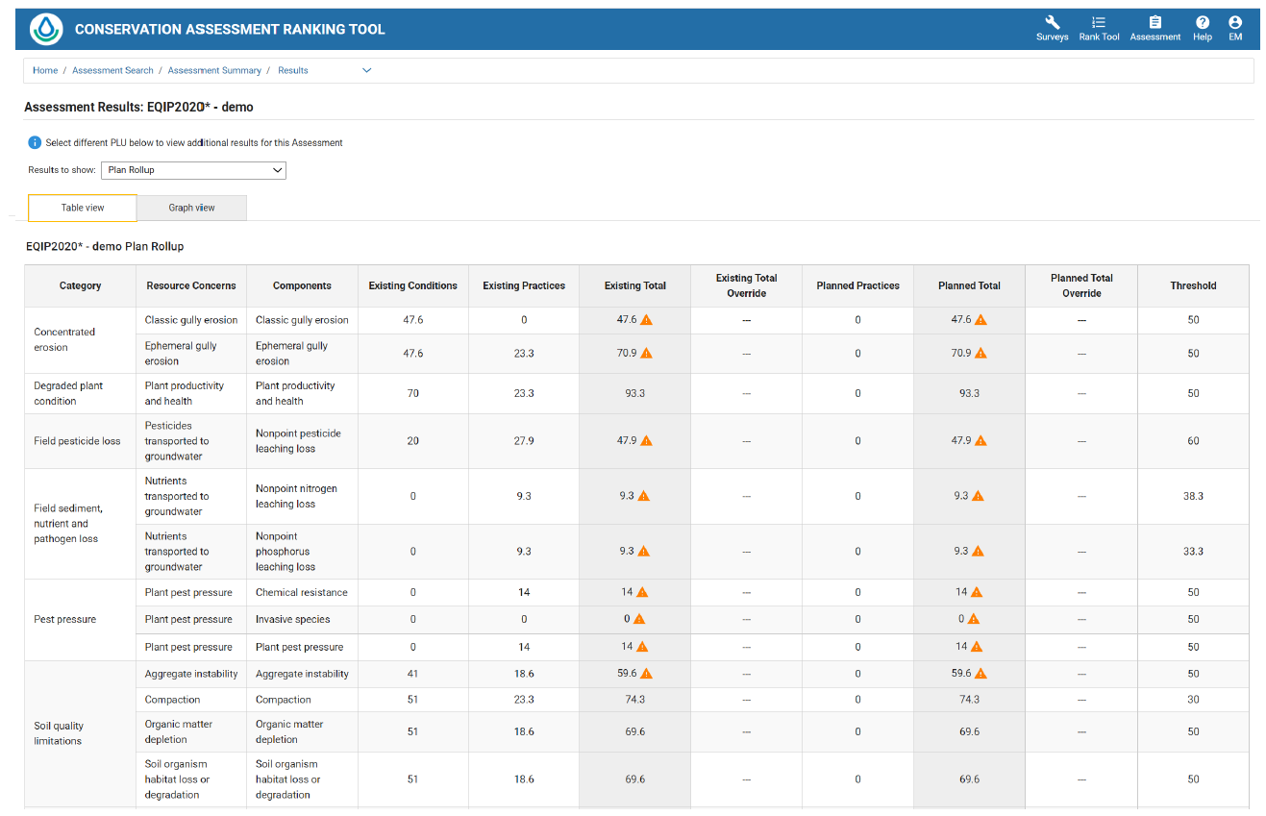
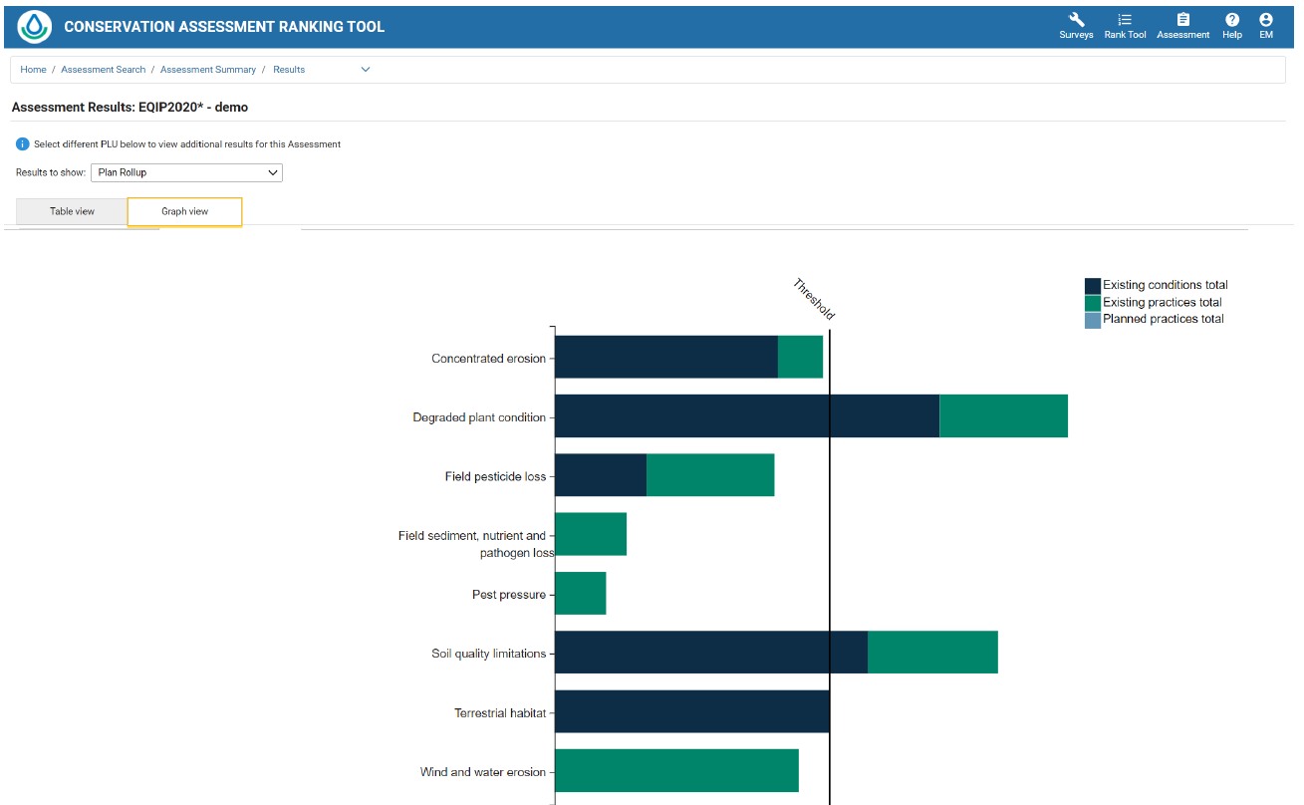
Current CART Results
Table View
Graph View

Slide 26
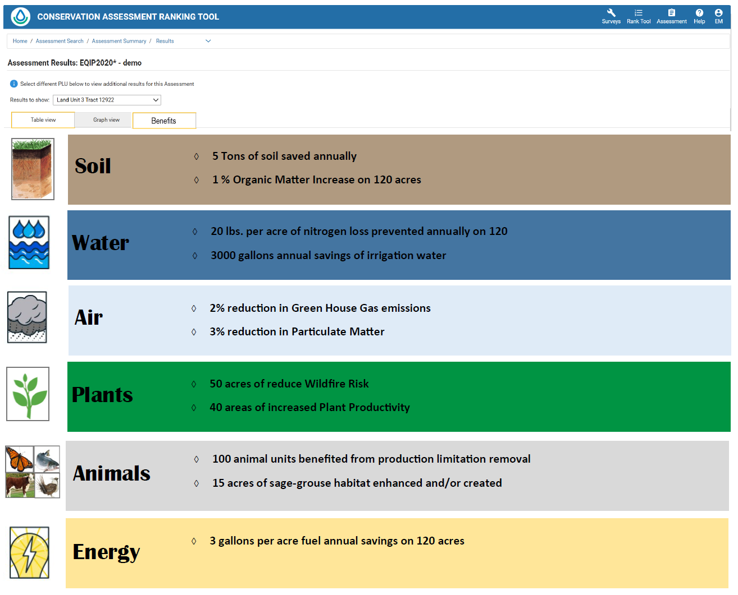
Individual Land Unit Benefits

Slide 27
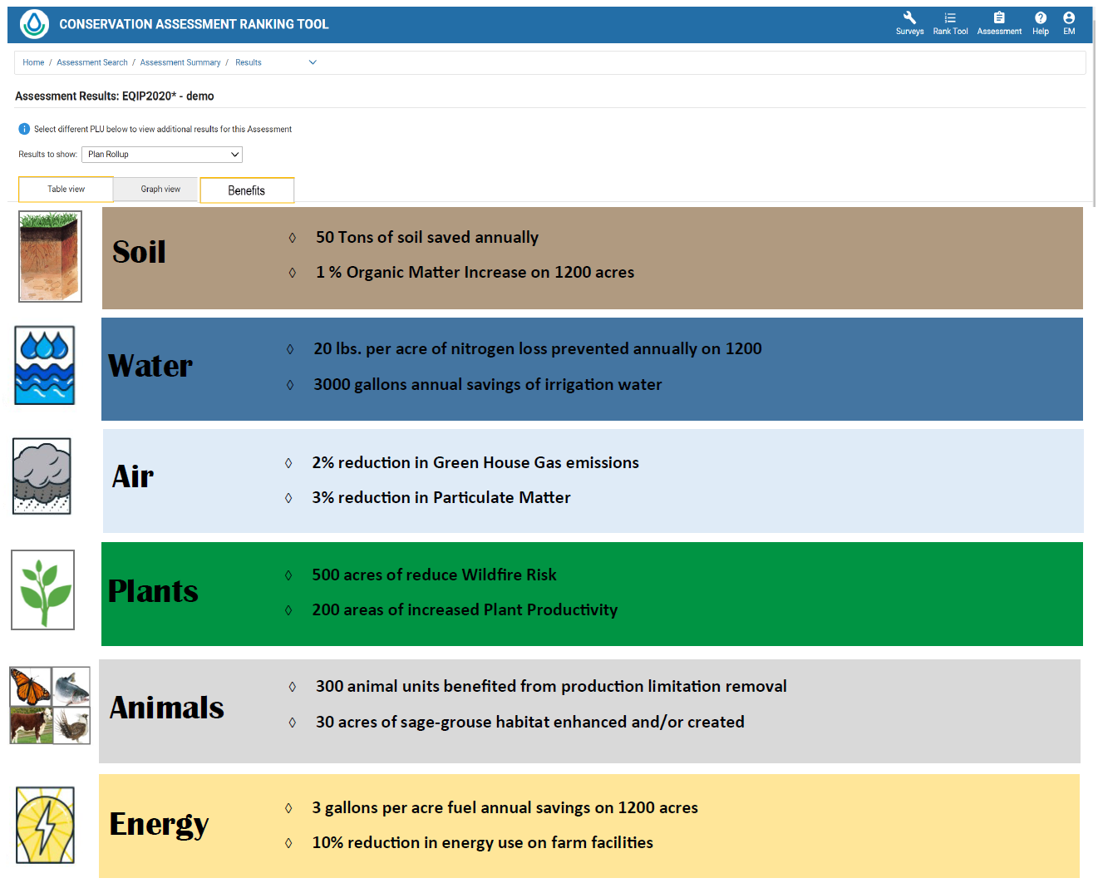
Plan Roll Up Benefits
Outcomes would be based on the RCs evaluated in the assessment
Planned condition – extent above existing benchmark
Appendix would explain how figures were derived
.

Slide 28
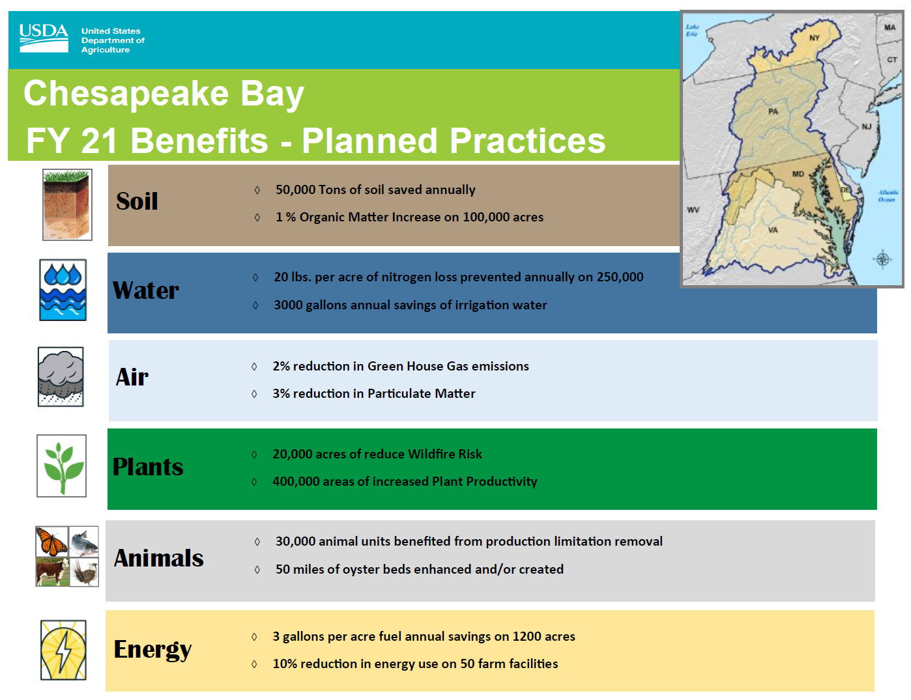
Landscape Benefits

Slide 29
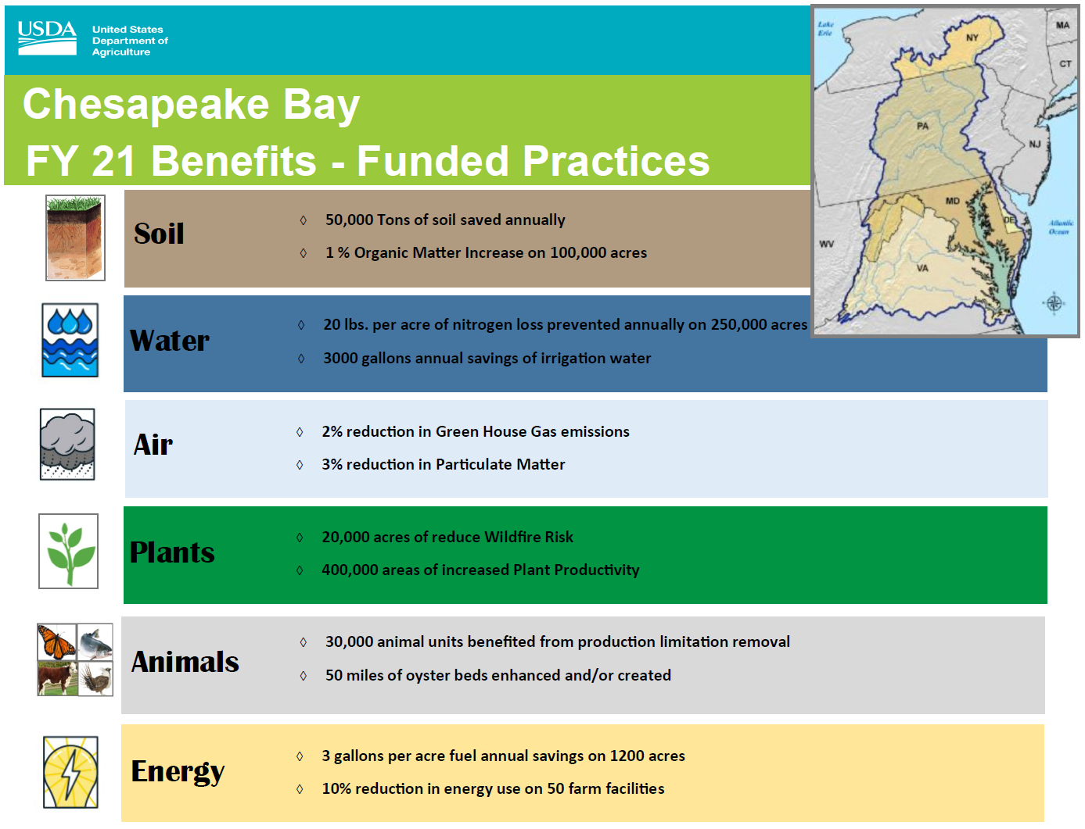
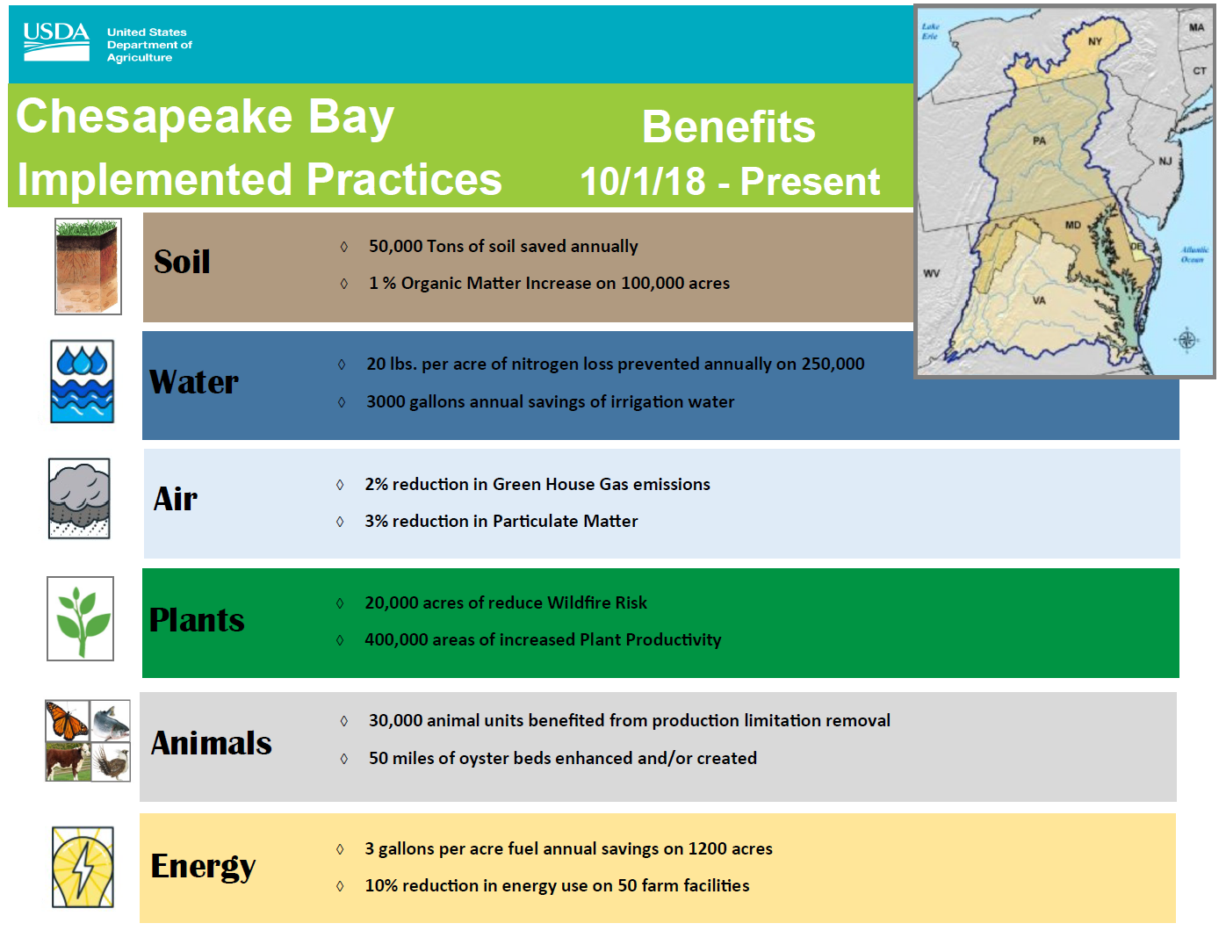
Planned, Funded, Implemented

Slide 30
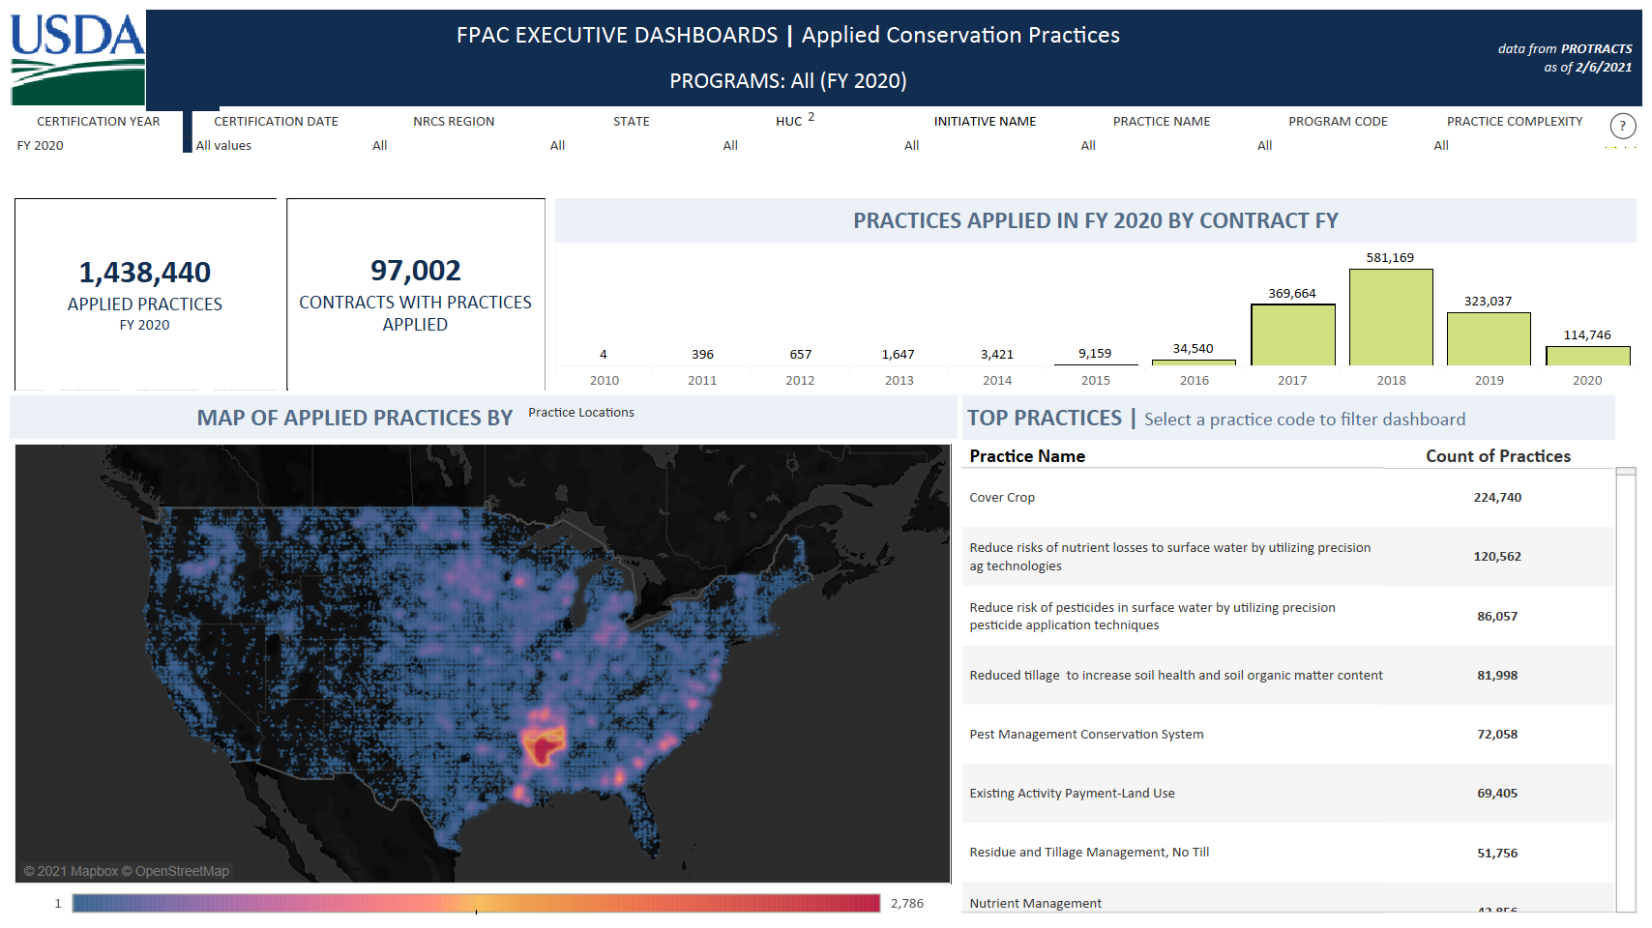
Planned, Funded, Implemented

Slide 31
CART Benefits Module
Environmental Benefits
Dynamic
Soil
HUB
CEAP, LGU
Research;
Empirical Data
Advanced
Benefits Services
CART Assessment
CART Benefits
Effects Tables
Practice Narrative Based or CART Points Change Based
CART Results
Land Unit/Plan Level
CART Benefits User Interface
Land Unit/Plan Level
Benefits Finder
Benefits Report
Land unit/Plan Level
CART Benefits
Data Storage
Land Unit/Plan Level
CPD
RIAD
Outcomes Team
ACT
Economics
CART Ranking
Efficiency Scoring
Benefits Report
Landscape/Watershed/Level
CD Reports

Slide 32
CART Benefits Module
Features Needed
Features Needed:
Configurable Data Structure at the Land Unit Level
Configurable Benefit Finder and Supporting Benefit Tables
Configurable Land Unit/Plan Level Products
Configurable Landscape/Watershed Level Reports
Beyond MVP:
Service Engine for Advanced Benefits (Integrated w/ surveys)
Environmental Benefits Area Planning Tools (e.g link w/ACPF)
Part of 3-Year IRB Plan

Slide 33

THANK YOU!
SPSD Leadership

Slide 34
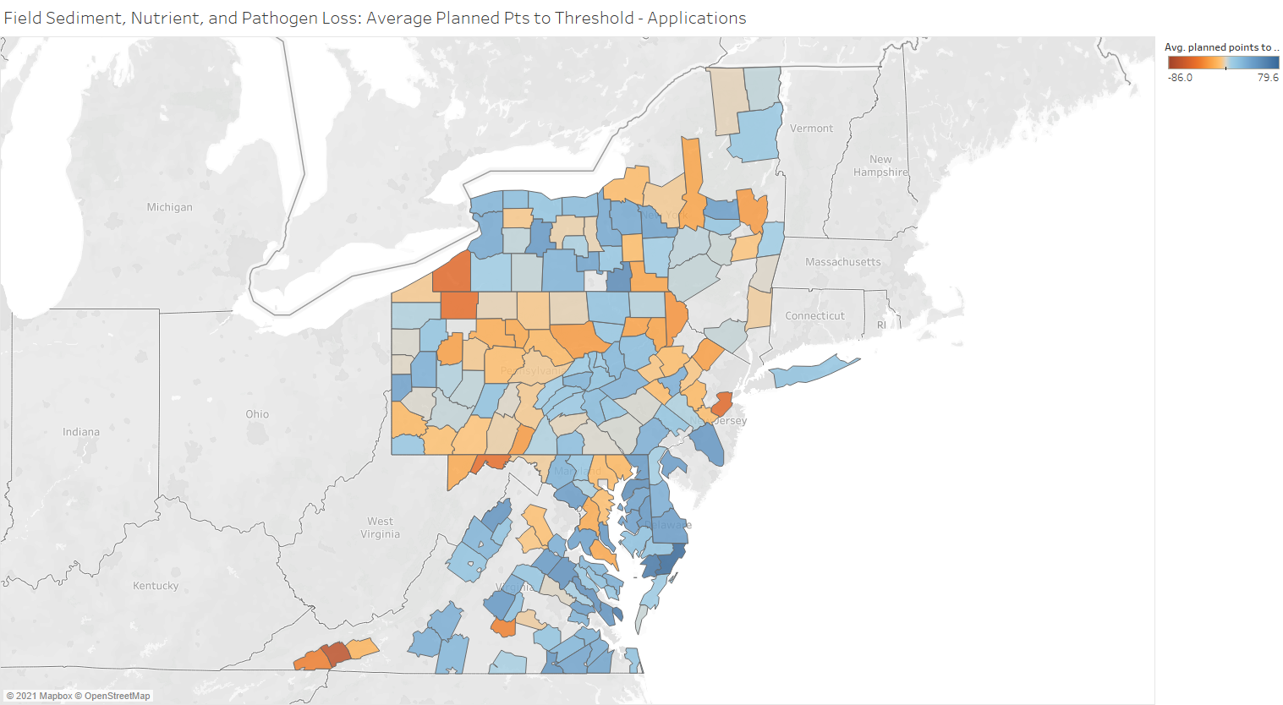
Environmental Benefits
Average Planned Condition
Geospatial + Existing Practice
for WQ Resource Concerns
on Cropland
APPLICATIONS
Notes:
Takes the “After Planning” counties and filters to include only those that went on to FY20 Applications (Active, Approved, Completed, Eligible, Pending, Preapproved statuses)

Slide 35
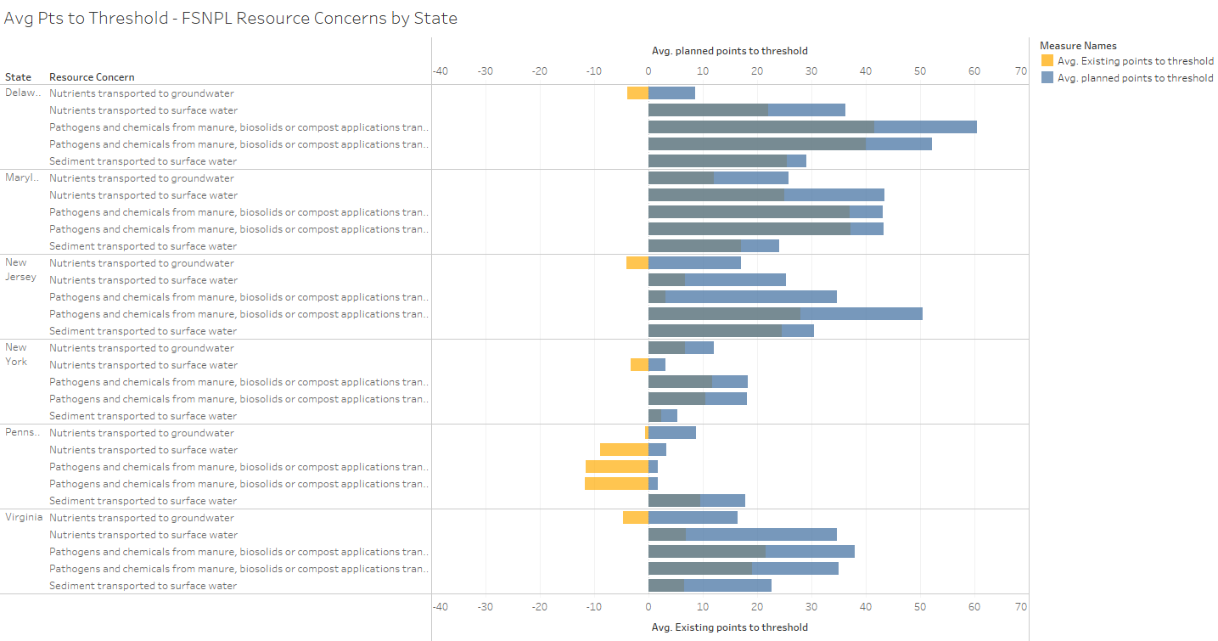
Notes:
FY20-21 Only the Field Sediment, Nutrient and Pathogen Loss RC - takes the average of each RC component for the entire state for existing points to threshold and planned points to threshold. Yellow would be average points below threshold, Blue would be points above threshold. Some were negative and moved to positive after planning (where you see yellow bars and then blue bars). Others were already above threshold but moved even higher above threshold w/ planning (where you see overlapping bars).
Can also do this analysis by county, for different RCC, etc.

Slide 36
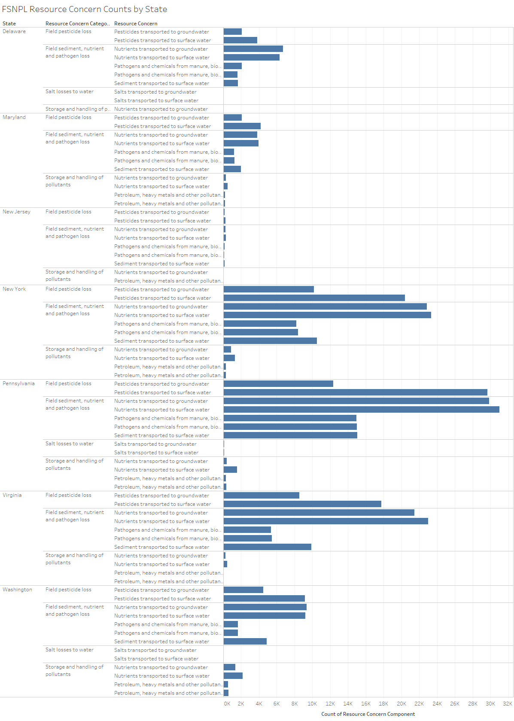
Notes:
For FY20-21 WQ RC categories (Field pesticide loss, FSNPL, Storage and handling of pollutants, Salt losses to water)- Count of RC Components by state

Slide 37
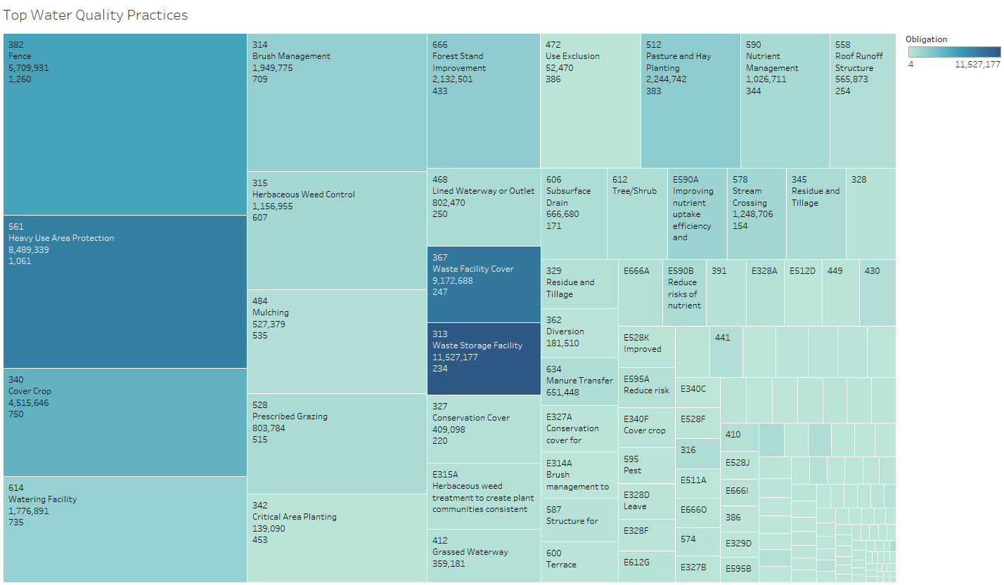
Environmental Benefits
Notes:
Limited to only practices associated with the 4 water quality resource concerns in CAPP – shows top practices for the Chesapeake Bay counties by relative count (size of rectangle), and obligation amount (color)
Square labels:
Practice Code
Practice Name
Sum of Obligation Amount in Selected States (FY20)
Sum of Contracts in Selected States (FY20)

Slide 38
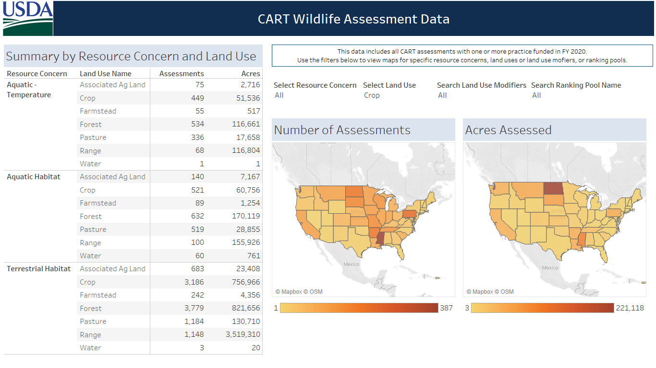
Environmental Benefits
Notes:
Limited to only practices associated with the 4 water quality resource concerns in CAPP – shows top practices for the Chesapeake Bay counties by relative count (size of rectangle), and obligation amount (color)
Square labels:
Practice Code
Practice Name
Sum of Obligation Amount in Selected States (FY20)
Sum of Contracts in Selected States (FY20)

Slide 39
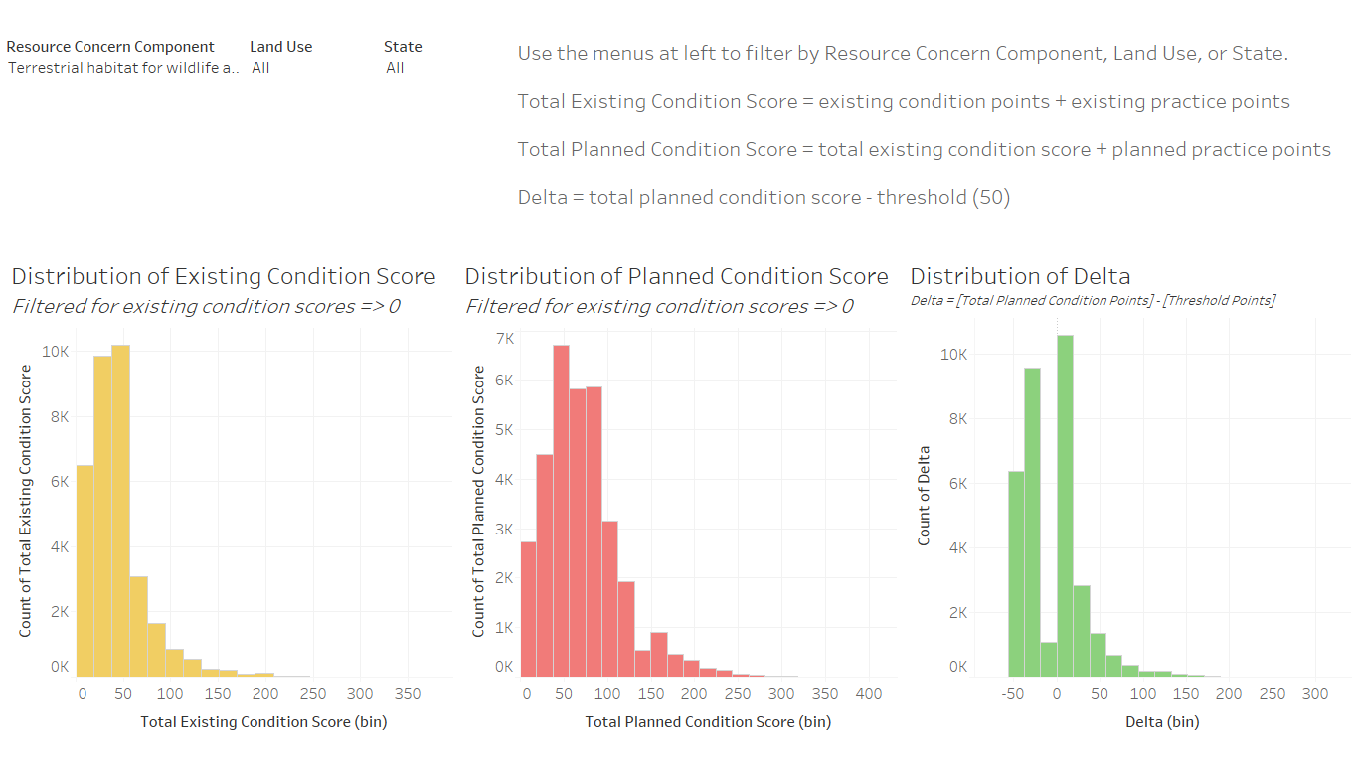
Environmental Benefits
Notes:
Limited to only practices associated with the 4 water quality resource concerns in CAPP – shows top practices for the Chesapeake Bay counties by relative count (size of rectangle), and obligation amount (color)
Square labels:
Practice Code
Practice Name
Sum of Obligation Amount in Selected States (FY20)
Sum of Contracts in Selected States (FY20)

Slide 40
Technical Review

Slide 41
Conservation Planning (CART) Benefits Module
Next Steps
Technical Review Team
Further Develop Environmental Benefits Framework
Evaluate Existing Environmental Benefits Data for readiness
Populate Version 1 Environmental Benefits Data
Explore options to expand and refine (CIG, Academic Study, Data Mining, Partners, CEAP Integration, Soil Interpretations, TSP Program, etc. [i.e. mature Levels of Environmental Benefits on priority basis])
CART Integration
Expand Metis Capacity (Get Funding)
Build Data Structure
Build UI
Build Data Engine
Build Reports and Products

Slide 42
Technical Review
Framework
Small group to evaluate considerations for module framework
Established a baseline for comparison
Consider time horizon of Environmental Benefits
Further develop Data Structure (CART Benefits Module)
Initiate process for modelling and date stamping
Explore public friendly reporting metrics and language, such as dump trucks of soil saved.
Incorporation of data caveats for reporting and usage for:
Conservation Planning and Program Delivery Reporting
Exporting to SSRA for Open Data Reporting and Outcomes

Slide 43
Technical Review
Existing Benefits Data
Create a cross Deputy Chief Search Team for Environmental Benefits data to:
Explore existing data sets for readiness
Develop translations and calculation methodologies
Populate ready data into Environmental Benefits database
Repeat

Slide 44
Technical Review
New Opportunities
Create one or more cross Deputy Chief teams to:
Develop requirements for new Environmental Benefits data development
Advertise opportunities to expand and/or update Environmental Benefits, such as CIG
Explore partnership opportunities and data sharing
Explore added client value opportunities, such as environmental service valuation and environmental markets.

